Slide 1
Power Board
Fuel Cell power in (24V)
Aux Power in (15V)
Convert Fuel Cell Power to 12V
Convert Fuel Cell Power to 5V
Convert Aux Power to 12V
Output to Relay Board and FC Controller
Relay Board
Contains Relays and Fuses
Motor Relay
Cap Relay
FC Controller Relay (Solid State)
Start Relay
Cap Charge Relay
Has Current and voltage probes
Cap Voltage
FC Voltage
Cap Current
FC Current
Main Controller
Teensy 3.2 MCU
Real Time Clock Board
Ambient Temp/Humidity Sensor
Sparkfun Open Log Board
CAN Bus Board
Pump Motor Driver
Fan Controller Running a PID Control algorithm

Slide 2
Fan Controller Inputs
Thermistors
2 Thermistors measure stack temperature
Tachometers
Used to read fan speed.
Can detect if fans are stalled
I2C
Fan controller talks with the rest of the board over i2c
Fan Controller Outputs
Fan Power
Can turn each fan on and off individually to save power when fans aren’t required
PWM
Pulse width modulation can control the speed of each fan independently
I2C
Transmits thermistor readings for datalogging purposes

Slide 3
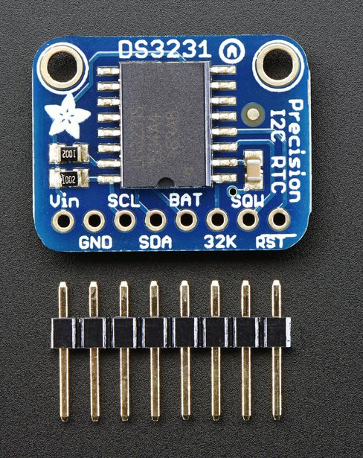
Adafruit DS3231 RTC
Temperature compensation for oscillator frequency
Battery lasts for years
Easy I2C interface

Slide 4
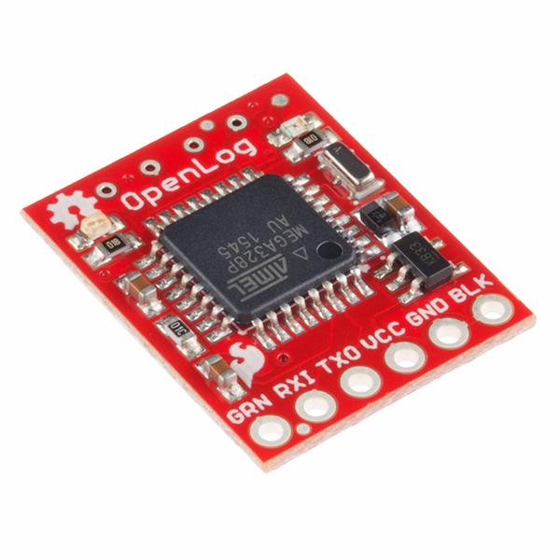
Sparkfun Open Log
Records Serial data to a SD card
Supports data rates of up to 115200bps and sd cards up to 64G
Will be great for debugging purposes and for science.

Slide 5
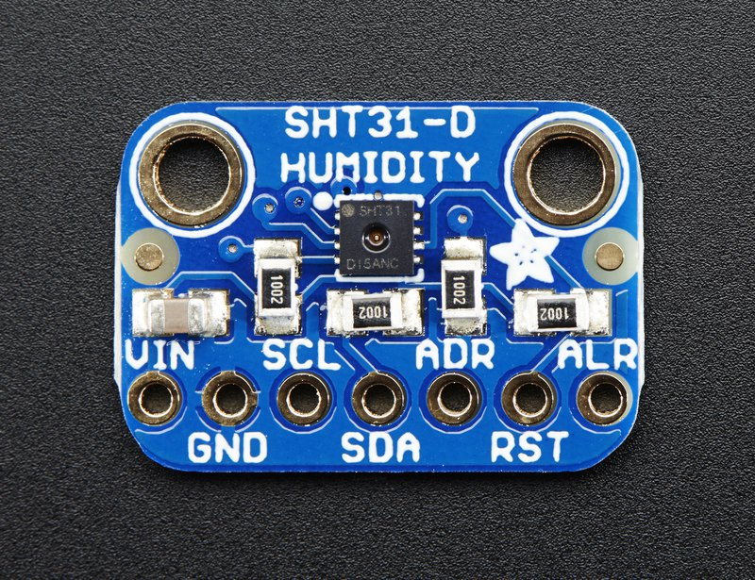
Adafruit SHT31-D Temperature & Humidity Sensor.
Temperature accuracy of +/- 0.3C
Humidity of +/-2%
There is a lot less space in the back of the prototype aeroshell. This will help us tell if the fuelcell is getting enough air.
Will also be good for science.
Talks to rest of controller over I2C

Slide 6
Relay Board

Slide 7
Inter-board connections
Using RJ 45 connectors for everything

Slide 8
Hydrogen detector board
MQ-8 hydrogen gas sensor
Can detect hydrogen concentrations for 100-10000ppm
Estop buttons are connected to this board
If Estop or Hydrogen is detected the motor turns off, caps are disconnected and hydrogen supply valve closes.

